Slide 1
COMP 249: Programming Methodology
Linked Data Structures
(Chap. 15)

Slide 2
We will not cover:
Section 15.2 (copy constructor & clone)
pp. 860-866 (Big-O notation)
Section 15.5 (Hash Tables)
Section 15.6 (Sets)
Section 15.3 (iterators) … will be covered in chap. 16

Slide 3
Static vs. Dynamic Structures
Often need to store and manipulate a group of objects, and:
  we will know the number and type of elements only at runtime
  the size may vary a lot at run time
what to do?
  array? arrayList? any thing better?

Slide 4
Static vs. Dynamic Structures
A static data structure has a fixed size
  NOTE: nothing to do with the Java static modifier
  ex: Arrays are static
    once you define the number of elements it can hold, it cannot be changed
A dynamic data structure can grow and shrink at run time
  ex: a linked data structure - implemented through our good friend: the reference

Slide 5
Object References
an reference is a variable that stores the address of an object in memory
  can also be called a pointer
student
name: John Smith
id: 40725
gpa: 3.58

Slide 6
References as Links
Object references can be used to create links between objects
  Ex: a Student class contains a reference to another Student object
name: John Smith
id: 40725
gpa: 3.57
nextStudent:
name: Jane Jones
id: 58821
gpa: 3.72
nextStudent:
null

Slide 7
A Linked List
studentList
Tail/rear/last
Head/front/first
null
Operations
  add element at the end/at the beginning
  insert element after another
  remove first/last element
  remove element after another
  find first/last/next element
  …

Slide 8
Example: Magazine.java
public class Magazine
{
private String title;
public Magazine (String newTitle)
{
title = newTitle;
}
public String toString ()
{
return title;
}
}

Slide 9
MagazineList.java
public class MagazineList {
private MagazineNode list;
public MagazineList() {
list = null;
}
private class MagazineNode {
public Magazine magazine;
public MagazineNode next;
public MagazineNode (Magazine mag) {
magazine = mag;
next = null;
}
}

Slide 10

MagazineList.java
public void add (Magazine mag) { // add at the end of the list
MagazineNode node = new MagazineNode (mag);
MagazineNode current;
if (list == null)
list = node;
else {
}
}
public String toString () {
String result = "";
return result;
}
}

Slide 11
MagazineRack.java
public class MagazineRack
{
public static void main (String[] args)
{
MagazineList rack = new MagazineList();
rack.add (new Magazine("Time"));
rack.add (new Magazine("Woodworking Today"));
rack.add (new Magazine("Communications of the ACM"));
rack.add (new Magazine("House and Garden"));
rack.add (new Magazine("GQ"));
System.out.println (rack);
}
}
output?

Slide 12
Example: Node1.java
public class Node1 {
private String item;
private int count;
private Node1 link;
public Node1() {
link = null;
item = null;
count = 0;
}
public Node1(String newItem, int newCount, Node1 linkValue) {
setData(newItem, newCount);
link = linkValue;
}
public void setData(String newItem, int newCount) {
item = newItem;
count = newCount;
}
…

Slide 13
LinkedList1.java
public class LinkedList1 {
private Node1 head;
public LinkedList1() {
head = null;
}
public void addToStart(String itemName, int itemCount) {
head = new Node1(itemName, itemCount, head);
}
public int size() {
int count = 0;
Node1 position = head;
while (position != null) {
count++;
position = position.getLink();
}
return count;
}
public void outputList(){
Node1 position = head;
while (position != null) {
System.out.println(position.getItem()+ " "+ position.getCount());
position = position.getLink( );
}
}

Slide 14
LinkedList1Demo.java
public class LinkedList1Demo {
public static void main(String[] args) {
LinkedList1 list = new LinkedList1( );
list.addToStart("Apples", 1);
list.addToStart("Bananas", 2);
list.addToStart("Cantaloupe", 3);
System.out.println("List has " + list.size() + " nodes.");
list.outputList();
if (list.contains("Cantaloupe"))
System.out.println("Cantaloupe is on list.");
else
System.out.println("Cantaloupe is NOT on list.");
list.deleteHeadNode();
if (list.contains("Cantaloupe"))
System.out.println("Cantaloupe is on list.");
else
System.out.println("Cantaloupe is NOT on list.");
while (list.deleteHeadNode())
; //Empty loop body
list.outputList( );
}
}
output?

Slide 15
Traversing a linked list
head
info
info
info
info
link
link
link
null
public void traverse() {
}

Slide 16
Adding at the End of a Linked List
head
info
info
info
info
link
link
null
link
New Node
public void addAtEnd(Node1 newNode) {
}

Slide 17
Deleting a Node from a Linked List
head
info
info
info
info
link
link
link
null
public void removeNode(Node1 nodeToDelete) {
}

Slide 18
Inserting a Node in a Linked List
head
info
info
info
info
link
link
link
null
info
New Node
link
public void insertNodeAfter(Node1 nodeToInsert, Node1 nodeBefore) {
}

Slide 19
Performance of Linked Lists
Linked Lists are fast for :
  Adding elements
  Removing elements
Linked Lists are slow for :
  Traversing the list
    ex: Checking if elements exist within the list
    ex: Finding elements
  Retrieving elements by index (random access)

Slide 20
Node as an Inner Class
A linked list can be made self-contained by making the node class an inner class
  Then no need for accessor and mutator methods in the node class
  The instance variables of the node can be accessed directly from methods of the outer class (the list)
see: LinkedList2.java

Slide 21
A Generic Linked List
A node that can hold objects of any class
LinkedList3.java & GenericLinkedListDemo.java
ex:
__________________________________________ // list of entries??
Entry entry1 = new Entry("Apples", 1);
list.addToStart(entry1);
…
__________________________________________ // list of students??
Student ali = new Student("Ali", 123);
comp249.addToStart(entry1);
…
public class Entry {
private String item;
private int count;
…
}
public class Student {
private String name;
private int ID;
private double mark;
…
}

Slide 22
LinkedList<T> Class
you could write a linked list yourself…
or just use LinkedList<T> from the Java Collection Framework (see chap. 16)

Slide 23
Variations on a Linked List (p.846)
a doubly linked list, with next and previous references
list
null
null

Slide 24
Variations on a Linked List
a circular list
  the last node in the list points to the first node in the list
list

Slide 25
Linear Data Structures
List
  Collection of elements in a particular order
  Queue
    Elements removed in order of insertion
    First-in, First-out (FIFO)
  Stack
    Elements removed in opposite order of insertion
    First-in, Last-out (FILO)

Slide 26
Queues
A queue is a list but:
  adds items only to the rear of the list and
  removes them only from the front
  FIFO data structure: First-In, First-Out
ex: ??
Used in:
  simulations or when items get “backed up” while awaiting processing (ex. print queue, event queue, …)
enqueue
dequeue

Slide 27
Stacks
A stack is a list but:
  adds items to one end
  removes items from same end
  LIFO data structure: Last-In, First-Out
ex: ??
Used where?
push
pop

Slide 28
Implementing Queues and Stacks…
a linked-list? an arrayList?
  array/arrayList
    maintaining order is expensive (inserting anywhere) is expensive
    accessing a specific element is not expensive
  linked list
    inserting anywhere is not expensive
    accessing a specific element (traversing) is expensive

Slide 29
Implementing Queues and Stacks…
The Java Collection Framework (JCF)
for stacks --> java.util.Stack<T>
  Since Java 1.0, java.util contains a Stack<T> class
  deprecated…
    does not fit into the JCF as well as other classes.
    its implementation is based on Vector class (itself deprecated)
  now, use a LinkedList<T> from the JCF
    (see later)

Slide 30
Example: Decode.java
public static void main (String[] args) {
Scanner scan = new Scanner(System.in);
Stack<Character> word = new Stack<Character>();
String message;
int index = 0;
System.out.println ("Enter the coded message:");
message = scan.nextLine();
while (index < message.length()) {
while (index < message.length() && message.charAt(index) != ' ') {
word.push(message.charAt(index));
index++;
}
while (!word.empty())
System.out.print(word.pop());
System.out.print (" ");
index++;
}
}
Input: Hi there!
Output?

Slide 31
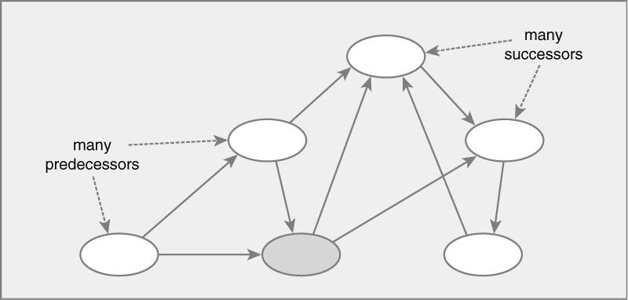
Graph Data Structures
Many-to-many relationship between elements
  Each element has multiple predecessors
  Each element has multiple successors

Slide 32
Different types of Graphs
Undirected graph -- Undirected edges
Directed graph (or digraph) -- Directed edges
  ex: airline flights between airports
Directed acyclic graph (DAG)
  Directed edges, no cycles
Undirected
Directed
DAG

Slide 33
Trees (p. 878)
Trees are a special type of graph
Specifically, they are:
  connected (no nodes just floating around in space)
  acyclic (no loops) graphs.
All trees are graphs
but not all graphs are trees.
They are very common in Computer Science – get used to the concept!

Slide 34
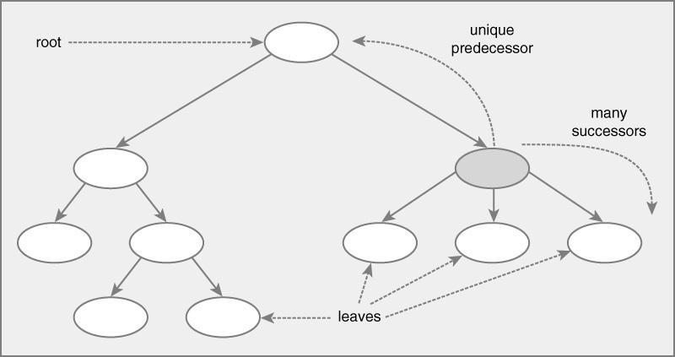
Trees
One-to-many relationship between elements
  Each element has unique predecessor
  Each element has multiple successors

Slide 35
Trees
Which of these are trees?

Slide 36
Binary Trees
Special type of tree
Binary tree : 0 - 2 children per node
  defined recursively:
    Either it is empty (the base case)
    or it consists of a root and two subtrees, each of which is a binary tree
Tree
Binary Tree

Slide 37
A Binary Tree
info
info
info
null
info
info
info
null
null
null
null
null
info
null
null

Slide 38
A Binary Search Tree
Special type of binary tree
A binary tree where each node contains:
    A value
    Link to the left child
    Link to the right child
  Values of children to the left are less than value in parent
  Values of children to the right are greater than or equal to value in parent
15
2
17
9
37
29
78

Slide 39
Example
order of insertion
Binary search tree?
15
17
37
2
9
117
29

Slide 40
Operations
We can do many things with a binary search tree.
ex:
  Summation of all values in the tree
  Print sorted representation of values
  Search for a specific value
So how do we do these things?

Slide 41
Binary Trees are naturally recursive
A binary tree is
  Either empty (the base case)
  or it consists of a root and at most 2 subtrees, each of which is a tree
So we can solve problems on trees by solving problems on sub-trees
can be done iteratively,
but it’s quite tedious to code

Slide 42

Example: IntTree.java
public class IntTree {
private static class IntTreeNode { // inner class
private int data;
private IntTreeNode leftLink;
private IntTreeNode rightLink;
public IntTreeNode(int newData, IntTreeNode newLeftLink,
IntTreeNode newRightLink) {
data = newData;
leftLink = newLeftLink;
rightLink = newRightLink;
}
} //End of IntTreeNode inner class
private IntTreeNode root;
public IntTree( )
{
root = null;
}
…

Slide 43
Traversing a binary tree
PreOrder traversal
  Process the data in the root node
  Process the left subtree
  Process the right subtree
InOrder traversal
  Process the left subtree
  Process the data in the root node
  Process the right subtree
PostOrder traversal
  Process the left subtree
  Process the right subtree
  Process the data in the root node

Slide 44
Printing a binary tree
15
base case:
  if a tree is empty (has no node)
    don't do anything
recursive case:
  print left subtree
  print current node
  print right subtree
2
17
9
37
29
78

Slide 45
Printing a tree: IntTree.java
// the print method starts at the root
public void showElements() {
showElementsInSubtree(root);
}
private static void showElementsInSubtree(IntTreeNode subTreeRoot) {
}

Slide 46
Inserting a node
29
if (new value < current value)
  if left sub-tree does not exist
    set new node as new left child of current node
  else
    insert node to left subtree
otherwise
  if right sub-tree does not exist
    set new node as new right child of current node
  else
    insert node to right subtree
15
2
17
9
37
15
2
17
9
37
29

Slide 47
Inserting a Node: IntTree.java
public void add(int item) {
root = insertInSubtree(item, root);
}
private static IntTreeNode insertInSubtree(int item, IntTreeNode subTreeRoot) {
if (subTreeRoot == null)
return new IntTreeNode(item, null, null);
else
else {
subTreeRoot.rightLink = insertInSubtree(item, subTreeRoot.rightLink);
return subTreeRoot;
}
}

Slide 48
Sum values of nodes
???
15
2
17
9
37
2+9+15+17+37

Slide 49
Efficiency of Binary Search Trees
It takes O(h) time to search a search tree of height h.
  if tree is short and fat…
    very efficient
    as efficient as the binary search on a sorted array
      worst-case scenario is O(log n), where n is the number of nodes in the tree
  if tree is tall and slim…
    very inefficient
    worst-case scenario… same as searching a linked list
      worst-case scenario is O(n)
Maintaining a tree so that it remains short and fat, as nodes are added, is known as balancing the tree
  A tree maintained in this manner is called a balanced tree

